Slide 1
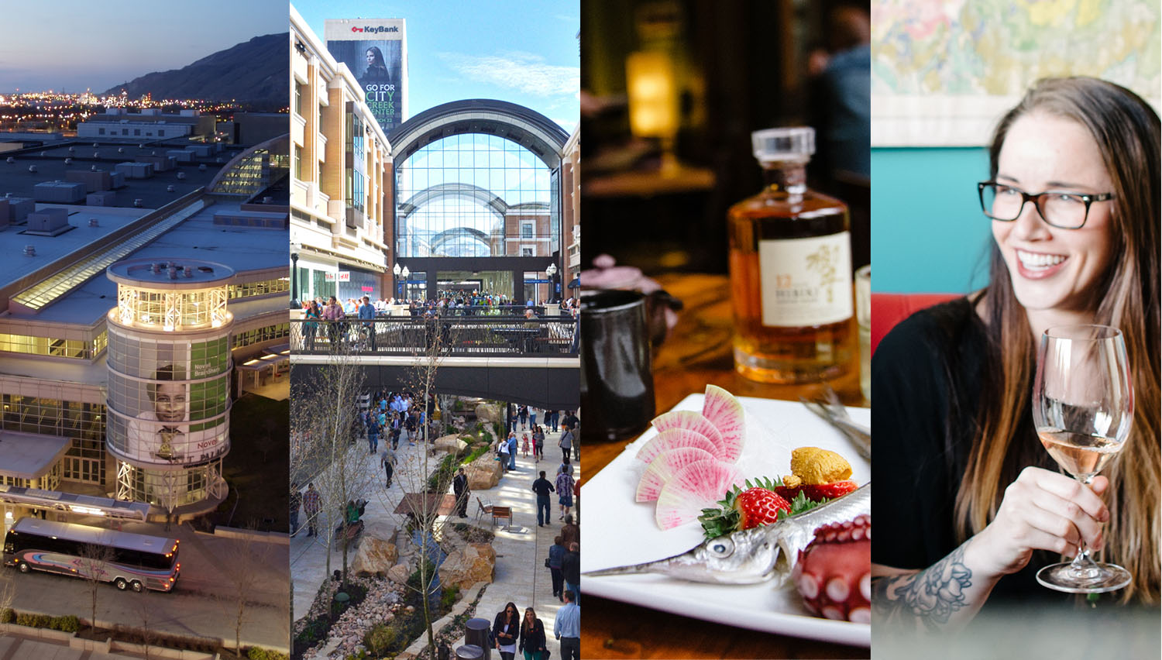

Slide 2
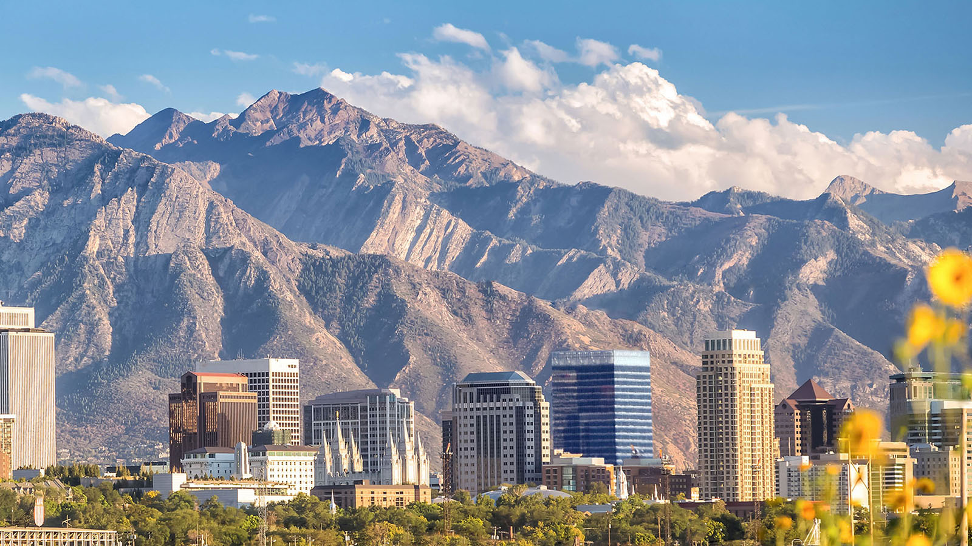


Slide 3
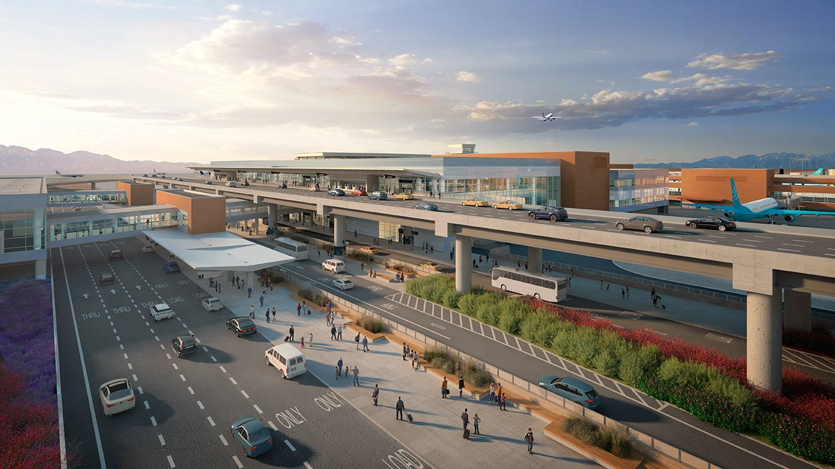
Easy Access
SLC International Airport

Slide 4
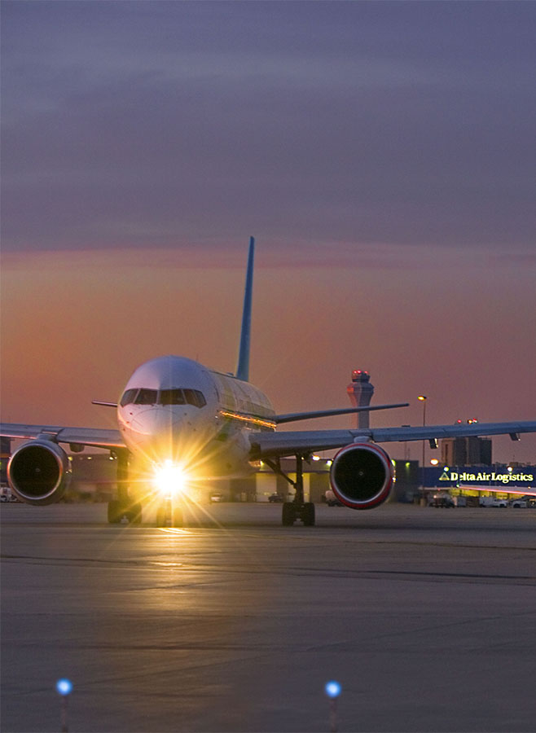
Served by all major U.S. airlines, including Delta’s Western hub.
The nation’s #1 on-time airport according to the US Department of Transportation.
700+ flights daily.
Direct daily flights from 100 cities, including Paris, London, Amsterdam, and Mexico City.
Easy Access
SLC International Airport

Slide 5
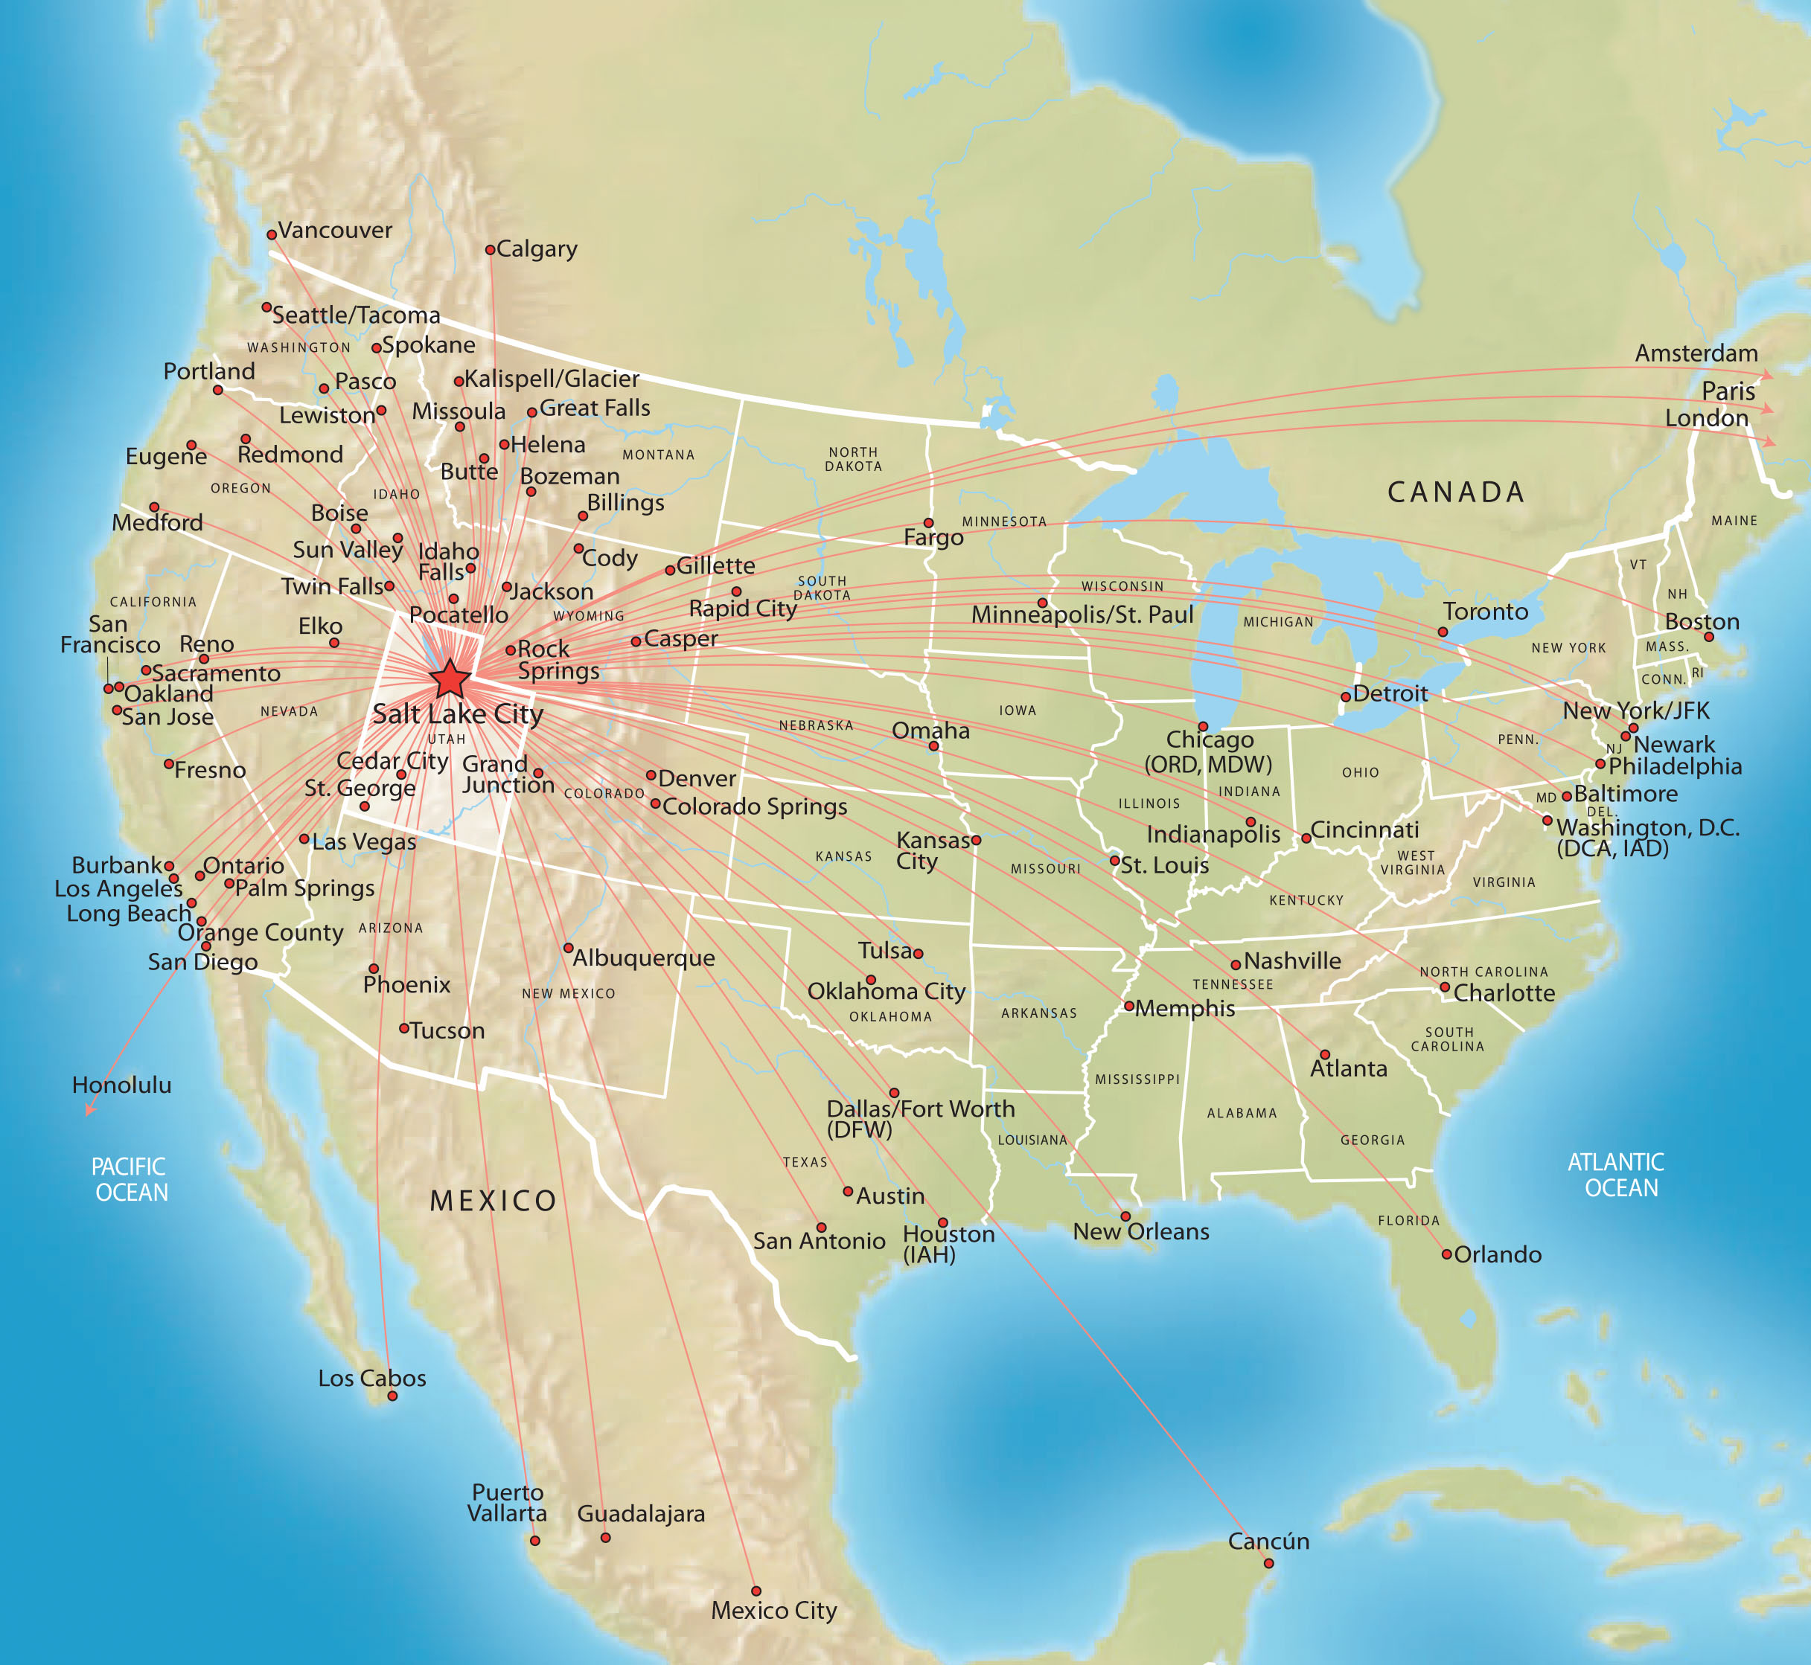
Direct Flights
SAMPLING OF CITIES WITH DAILY DIRECT FLIGHTS | NUMBER OF DIRECT FLIGHTS | LOWEST ROUND-TRIP WEB FARE
Atlanta, GA | 6 | $371
Baltimore, MD | 3 | $377
Boston, MA | 4 | $587
Charlotte, NC | 3 | $423
Chicago, IL | 16 | $382
Dallas, TX (all airports) | 18 | $317
Denver, CO | 29 | $127
Los Angeles, CA | 21 | $184
Minneapolis, MN | 6 | $419
New York City (all airports) | 4 | $503
Orlando, FL | 5 | $370
Phoenix, AZ | 20 | $211
Sacramento, CA | 6 | $171
San Francisco, CA | 19 | $167
Seattle, WA | 12 | $282
St. Louis, MO | 2 | $332
Washington, DC | 2 | $484
Round-trip prices as of April, 2017. These fares are provided for information only. Fares may change daily
and seats are subject to availability. Advance ticket purchase and other restrictions may apply.
Fare Source: www.google.com/flights Flight Information: www.slcairport.com

Slide 6
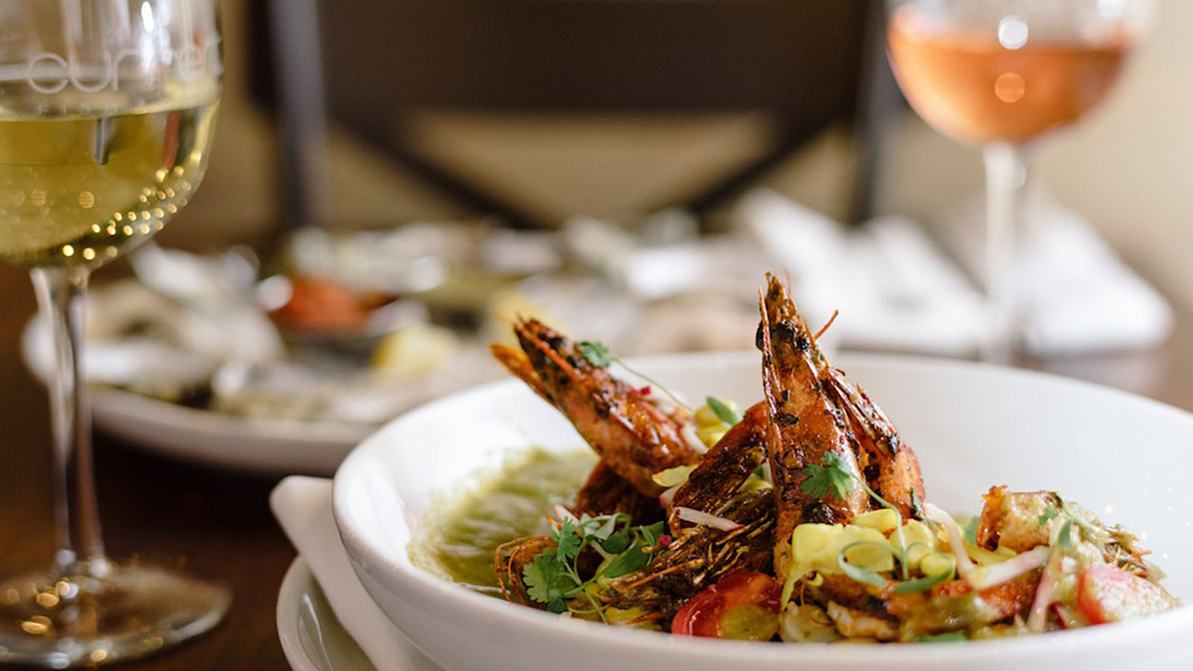
Restaurants & Bars

Slide 7
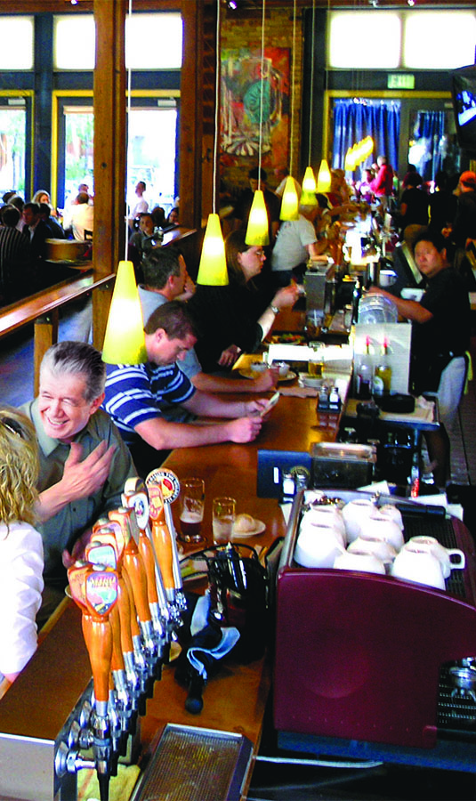
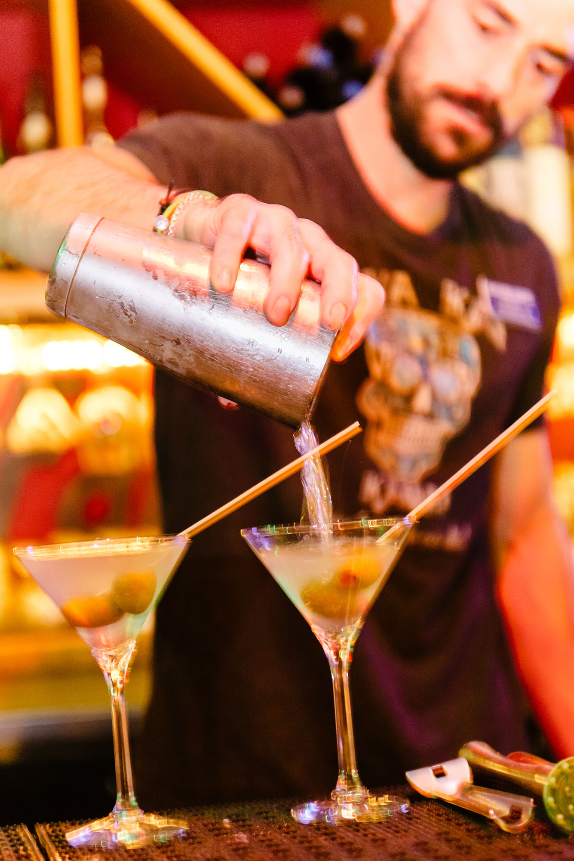
200+ restaurants and bars in the walkable convention district.
Nine brewpubs and six distilleries in and around Salt Lake.
Restaurants & Bars
“Exploring Salt Lake’s sophisticated and shockingly affordable restaurant scene is an adventure all its own. From some of the best Indian cuisine in the country at Bombay House to the Red Iguana, a classically raucous Mexican spot known for their delicious moles and stiff margaritas.”
- Men’s Journal, July 2016 Issue
Squatters Pub Brewery

Slide 8
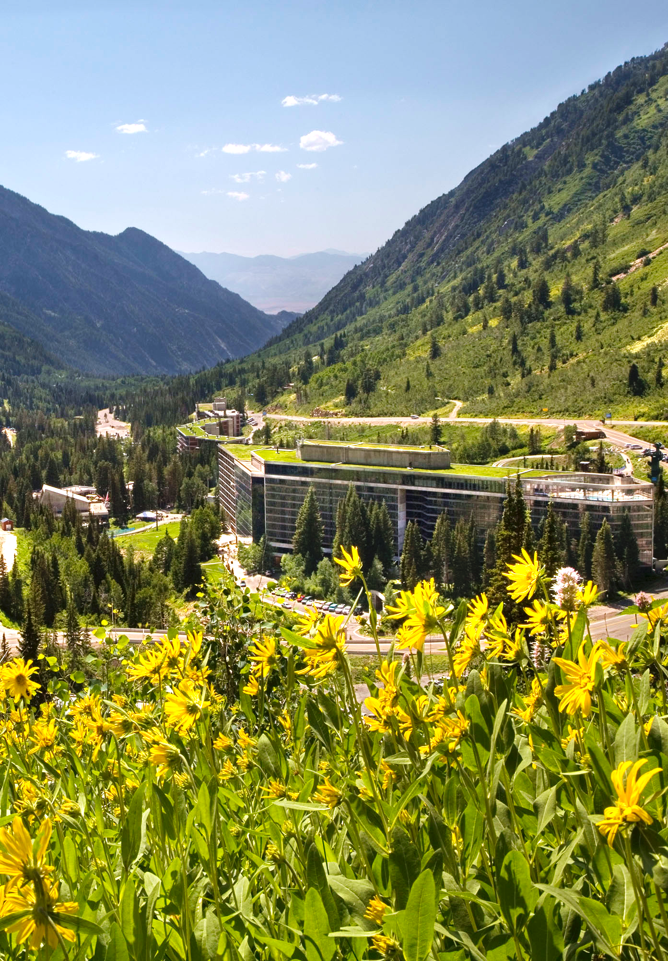
Four world-class alpine resorts just 35 minutes from the airport.
Seasonal activities such as skiing, snowboarding, mountain biking, hiking, zip lines, and unique team-building experiences.
Modern mountain meetings facilities that can host up to 300 people.
Mountain Meetings
The Cliff Lodge at Snowbird

Slide 9
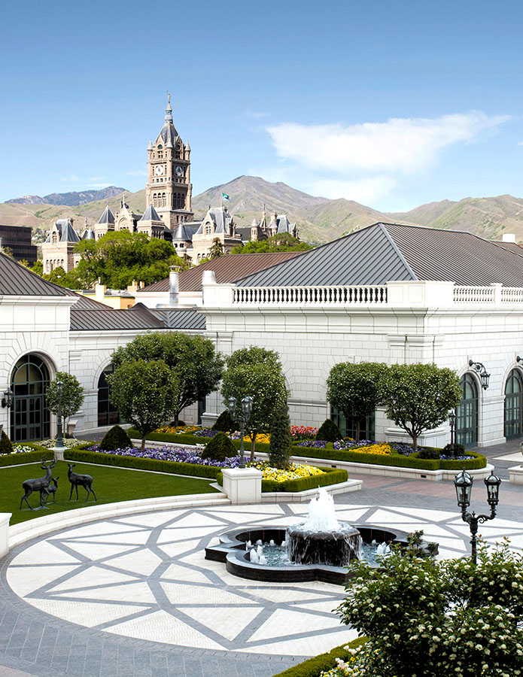
Located in the heart of downtown, The Grand America is among the nation’s finest hotels.
Luxurious fine furnishings and extraordinary amenities, with today’s best technology.
Flexible conference space for up to 3,000 guests.
75,000 square feet of meeting space with three exquisite ballrooms.
One of the USA’s Top Ten 5-Star Hotels according to Trivago.com (2018).
Luxury Meetings
The Grand America

Slide 10
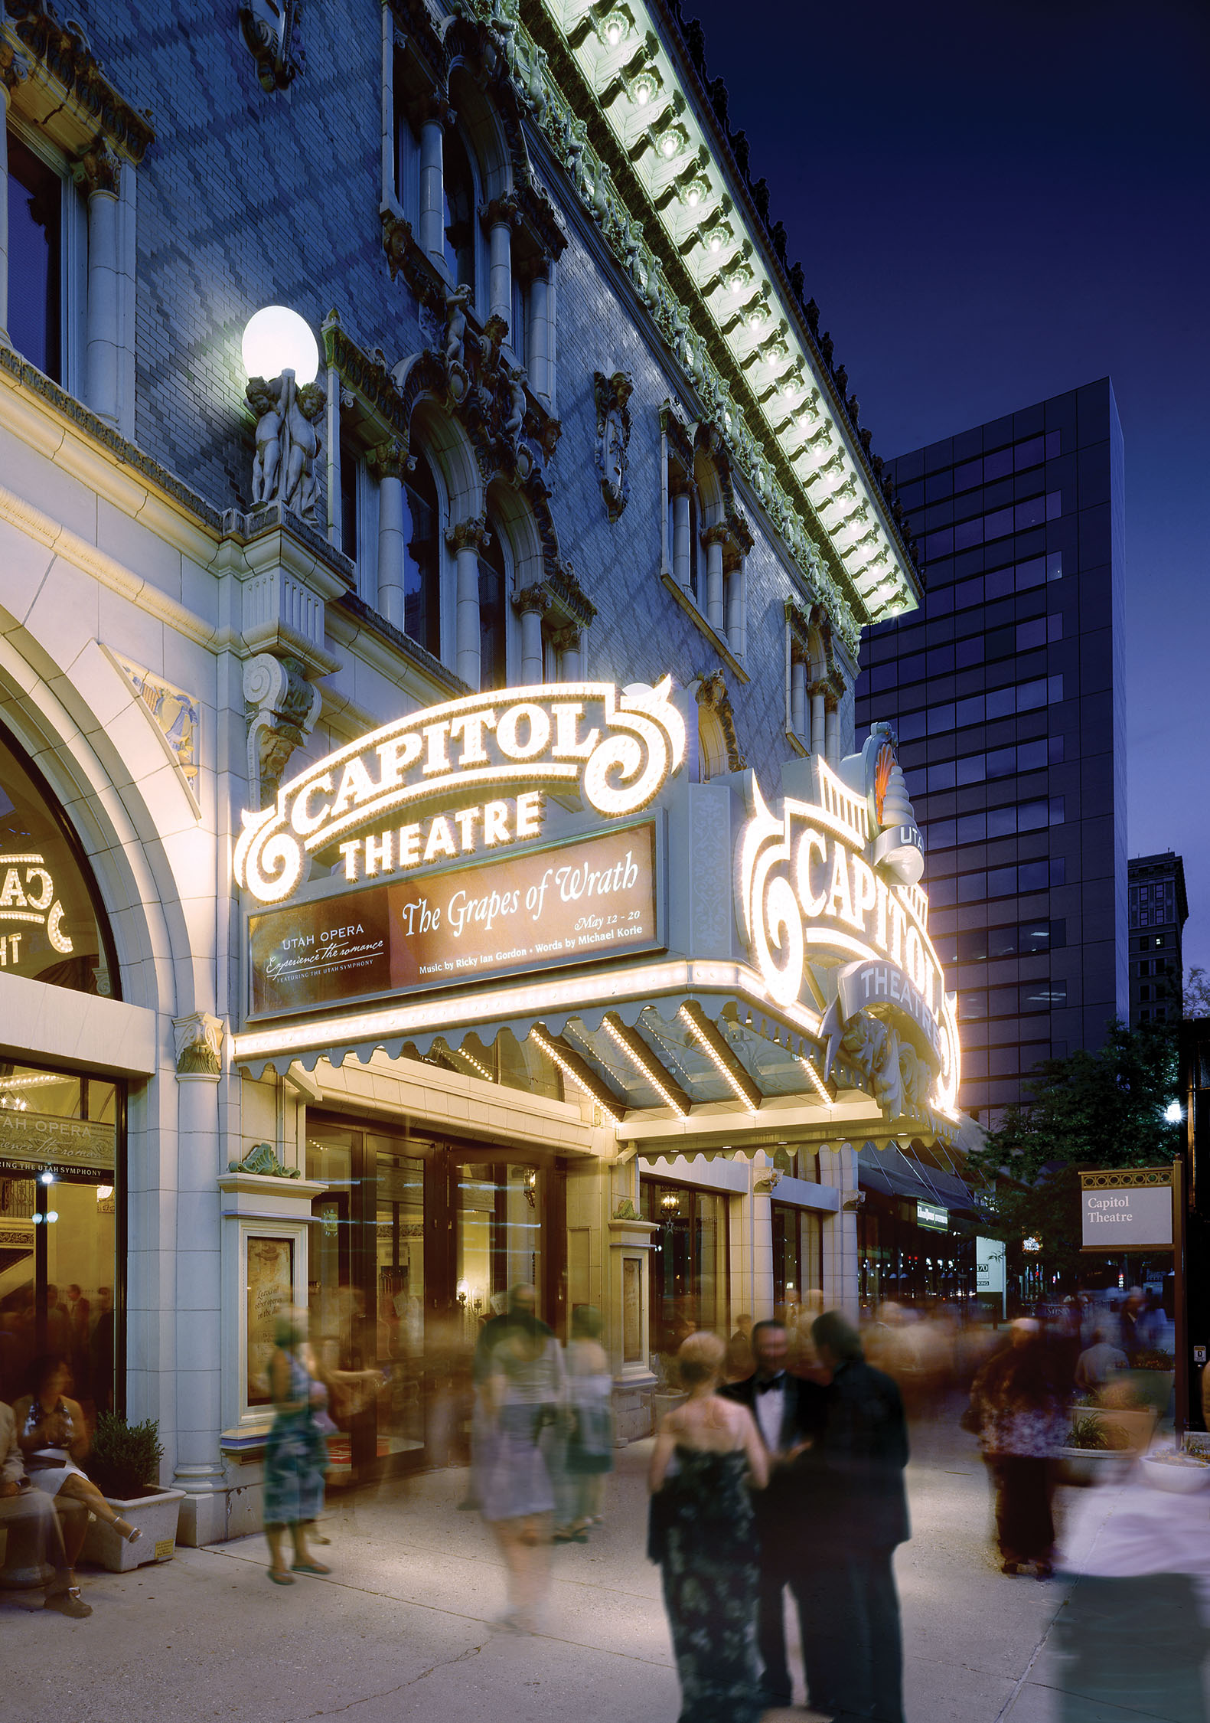
The convention district is clean, friendly, and compact.
Two major shopping centers, including the ”Best Retail Development in the Americas (City Creek Center).”
Major opera, ballet, symphony, and Broadway theater.
Six museums, planetarium, and IMAX theater.
NBA basketball.
A day’s worth of admission – free attractions associated with Historic Temple Square, including the Mormon Tabernacle Choir.
Over 200 restaurants, bars, and brewpubs.
In The Convention District
Capitol Theatre

Slide 11
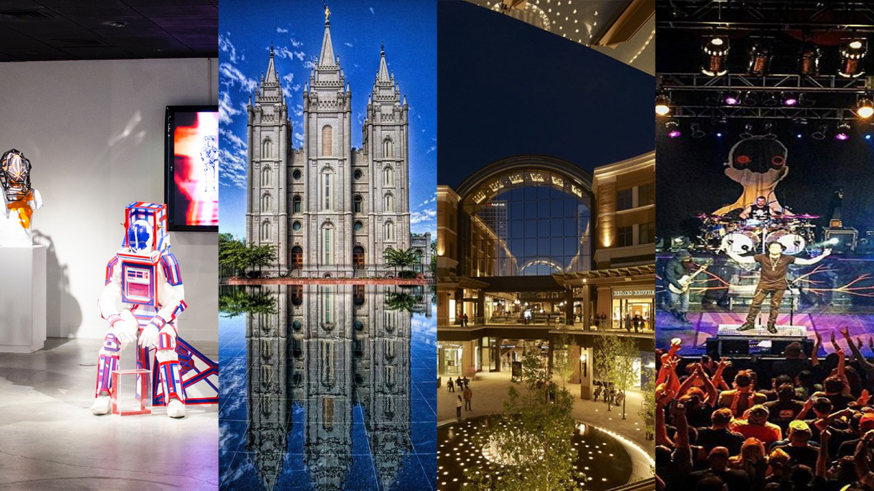
In The Convention District
Utah Museum of Contemporary Art
The Depot Nightclub & Concert Venue
Temple Square
City Creek Center

Slide 12
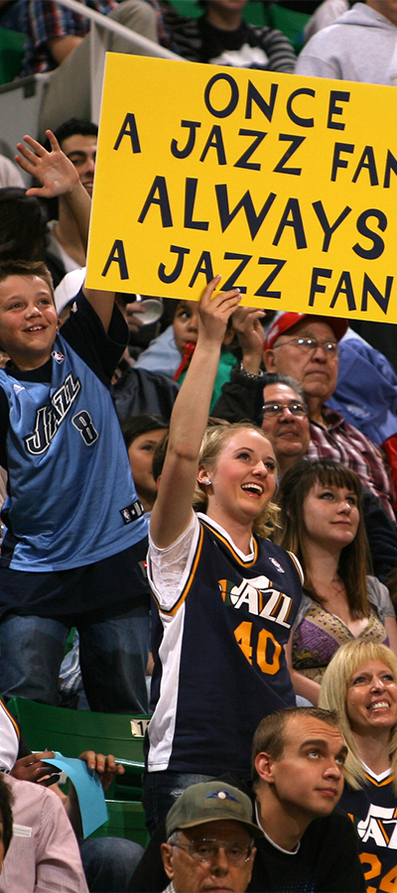
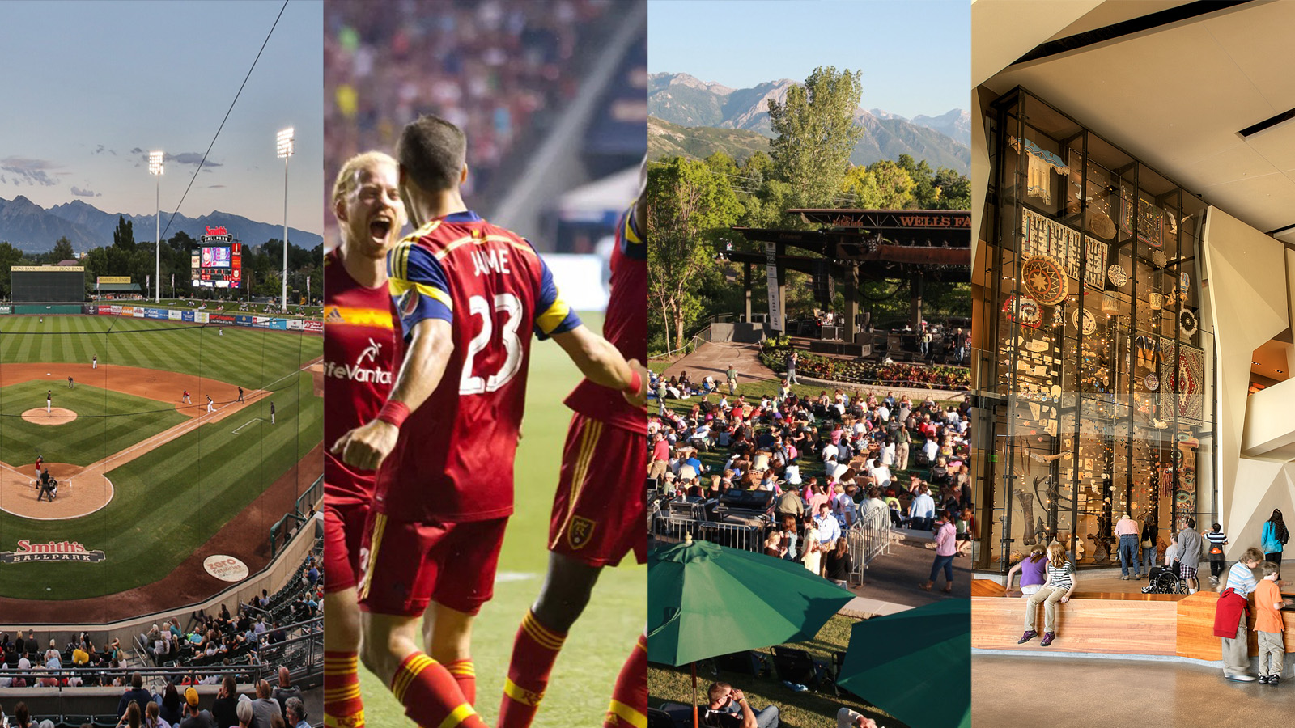
Beyond The Convention District
Major League Soccer
Red Butte Garden
Smith‘s Ballpark
Utah Jazz
Notes:
These attractions are great for pre/post attractions, great for spouse programs, and for off-site group venues.

Slide 13
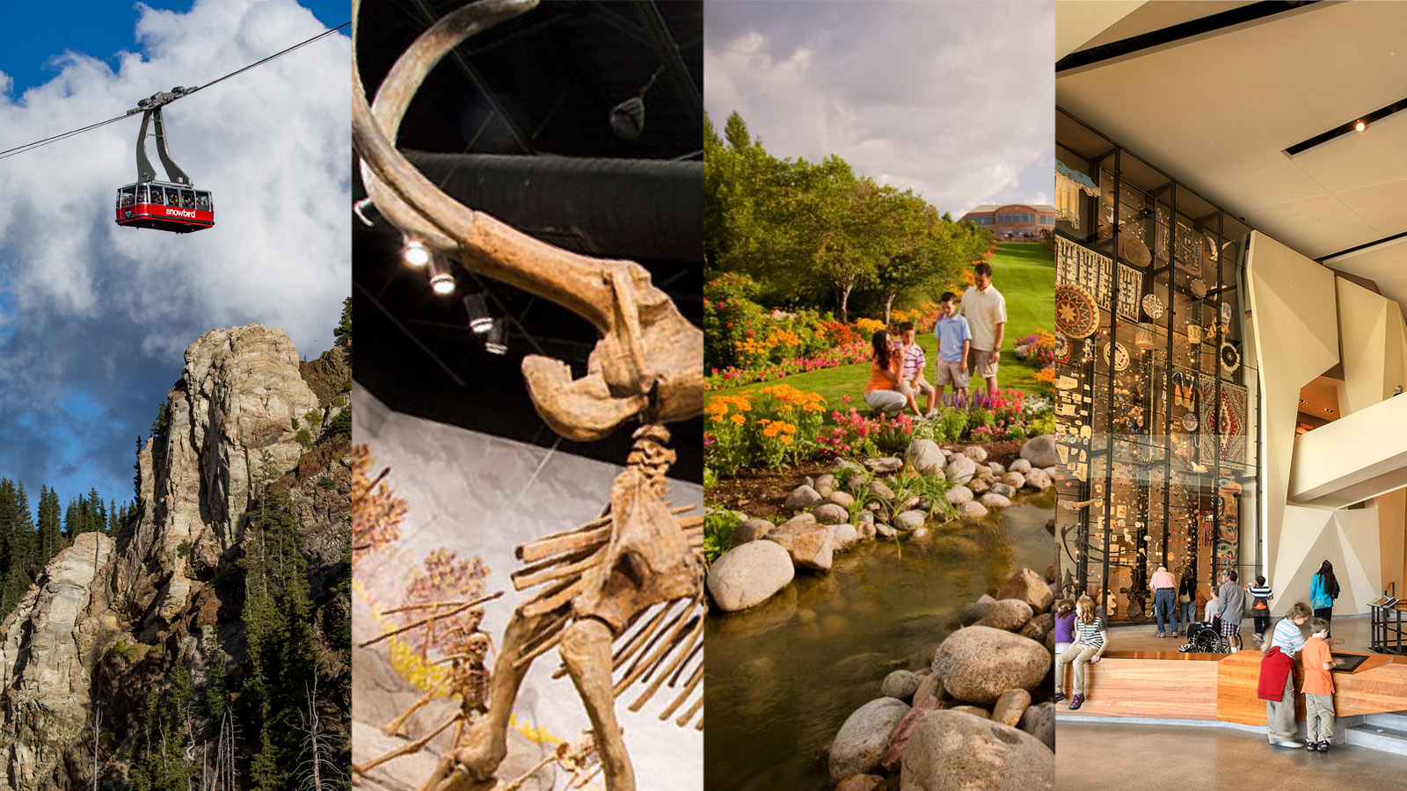
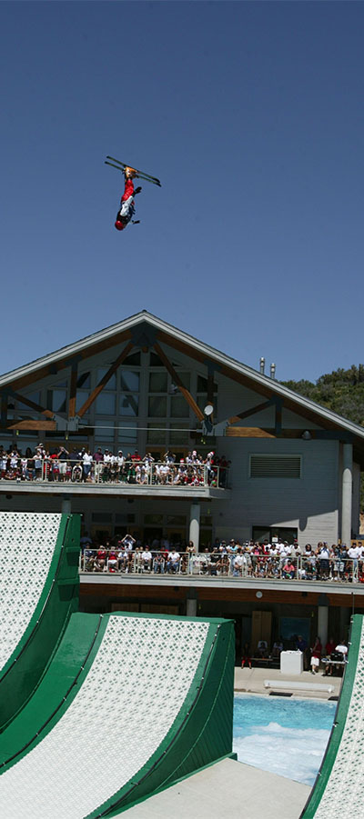
Beyond The Convention District
Museum of Ancient Life
Utah Olympic Park
Natural History Museum of Utah
Snowbird

Slide 14
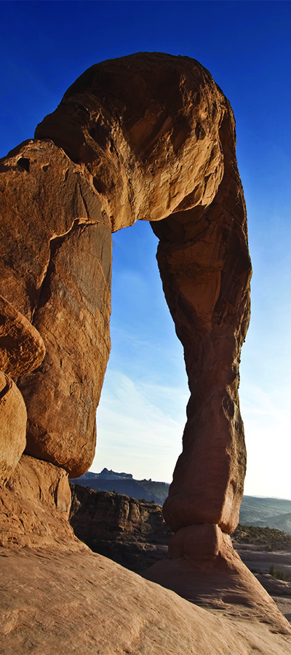
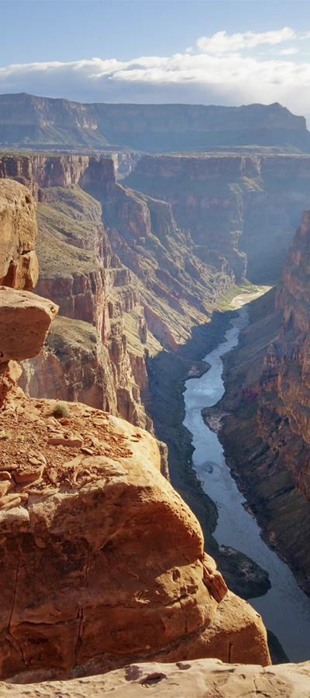
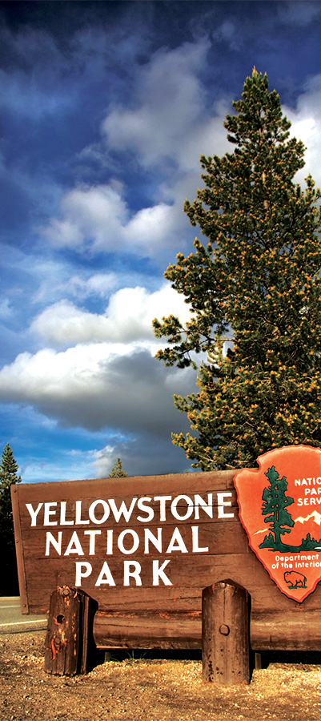
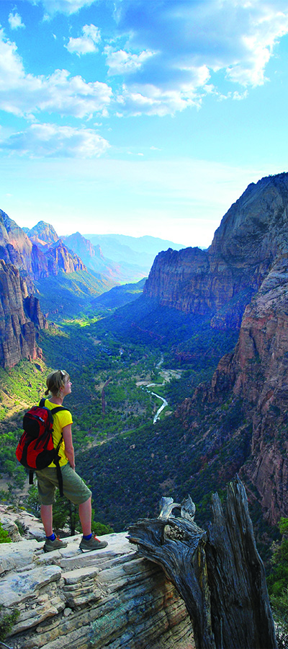
Within A Day’s Drive
Arches National Park
Grand Canyon
Yellowstone
Zion National Park

